Slide 1
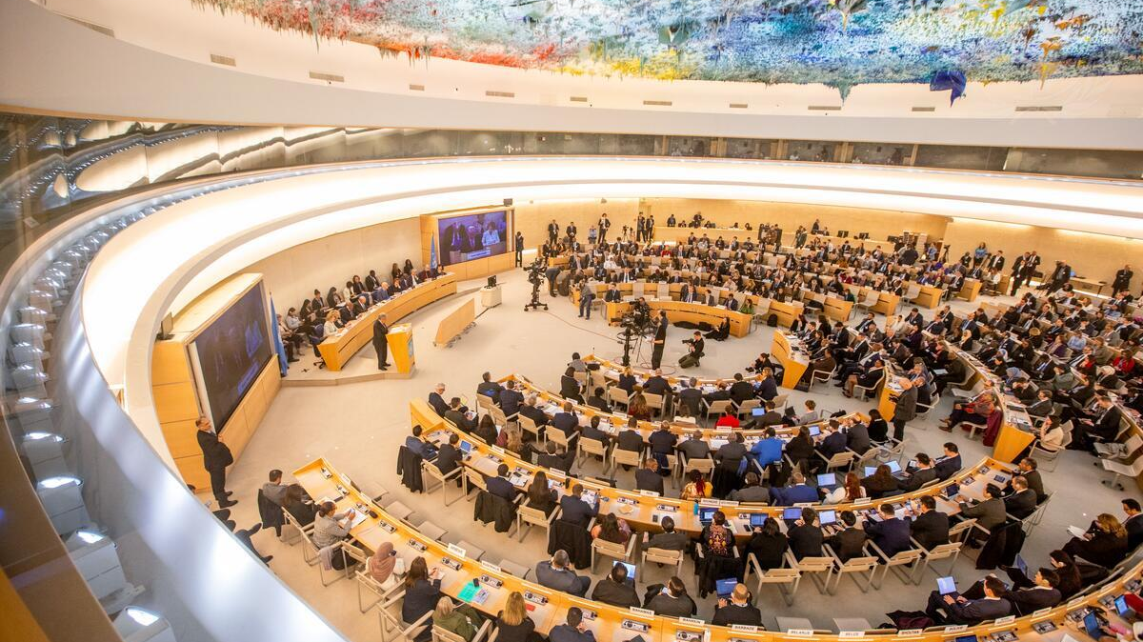


International Human Rights Law
LAWS2000/8015

Slide 2

Lecture Summary
History and foundations of international human rights law
UN International Human Rights Framework, including the International Bill of Rights
Categories of rights
Scope of and restrictions on international human rights
International monitoring mechanisms

Slide 3

Early Instruments
History and Foundations
Magna Carta (1215)
English Bill of Rights (1689)
French Declaration of the Rights of Man and of the Citizen (1789)
US Constitution (1789) and US Bill of Rights (1791)

Slide 4
History and Foundations
Enlightenment period
John Locke
In the Two Treatises of Government (1689), he defended the claim that men are by nature free and equal against claims that God had made all people naturally subject to a monarch. He argued that people have rights, such as the right to life, liberty, and property, that have a foundation independent of the laws of any particular society.
Emmanual Kant
Groundwork for the Metaphysics of Morals (1785) all persons have an inherent value, or dignity. This commands a distinct kind of moral respect and limits in our treatment of others. Human beings must be treated “as an end” and “never merely as a means”

Slide 5
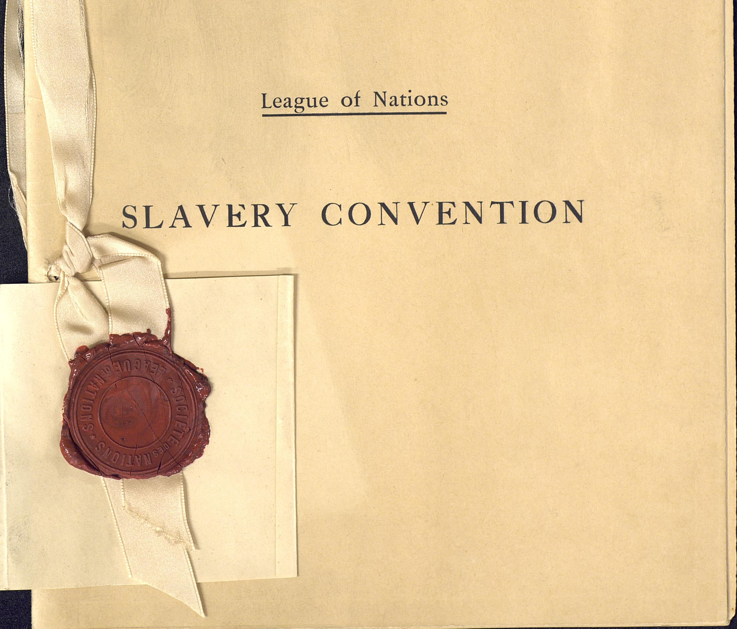
History and Foundations
19th - 20th Century
The beginning of the international human rights (issue-specific)
  Abolition of slavery (Britain in 1807), then in other European countries and 1926 Slavery Convention
  Women's rights (limited): trafficking in women for prostitution
WW2 and Nazi Regime

Slide 6
UN and Human Rights
UN Charter and Human Rights
Article 1 (3)
The Purposes of the United Nations are:
…
promoting and encouraging respect for human rights and for fundamental freedoms for all without distinction as to race, sex, language, or religion…
Article 55 (c)
With a view to the creation of conditions of stability and well-being which are necessary for peaceful and friendly relations among nations based on respect for the principle of equal rights and self-determination of peoples, the United Nations shall promote:
…
universal respect for, and observance of, human rights and fundamental freedoms for all without distinction as to race, sex, language, or religion.
Article 56
All Members pledge themselves to take joint and separate action in co-operation with the Organization for the achievement of the purposes set forth in Article 55.

Slide 7
UN and Human Rights
The International Bill of Rights
The International Bill of Rights
International Covenant on Civil and Political Rights (ICCPR)
International Covenant on Economic, Social and Cultural Rights (ICESCR)
Universal Declaration of Human Rights (UDHR)

Slide 8
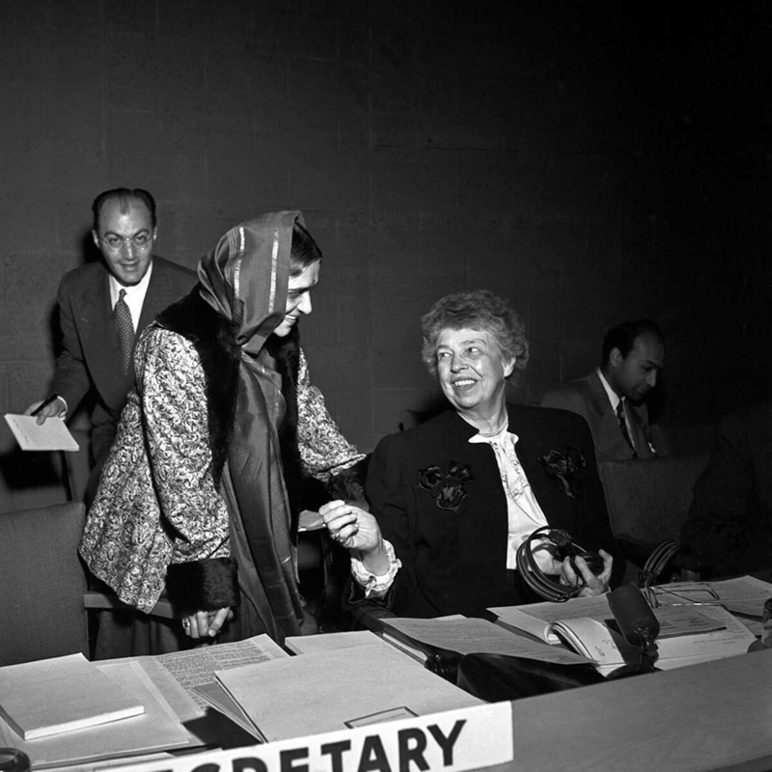
UDHR
10 Dec 1948
Article 2
Everyone is entitled to all the rights and freedoms set forth in this Declaration, without distinction of any kind, such as race, colour, sex, language, religion, political or other opinion, national or social origin, property, birth or other status. Furthermore, no distinction shall be made on the basis of the political, jurisdictional or international status of the country or territory to which a person belongs, whether it be independent, trust, non-self-governing or under any other limitation of sovereignty.
Article 3 (right to life, liberty, and security of person)
Article 5 (prohibition on torture)
Article 6 (right to recognition as a person before the law)
Article 7 (equality before the law)
Article 9 (prohibition on arbitrary arrest and detention)
Article 12 (right to privacy, family, and home)
Article 13 (right to freedom of movement)
Article 20 (freedom of peaceful assembly and association)
Article 26 (right to education)
Article 23 (right to work)
Women delegates from various countries played a key role in getting women’s rights included in the Declaration. Hansa Mehta of India (standing above Eleanor Roosevelt) is widely credited with changing the phrase "All men are born free and equal" to "All human beings are born free and equal" in Article 1 of the Universal Declaration of Human Rights.

Slide 9
UN and Human Rights
ICCPR & ICESCR
ICCPR
Art 6: Right to life
Art 7: Prohibition on torture
Art 8: Prohibition on slavery
Art 9: Right to liberty and security
Art 10: Rights in detention
Art 11: No imprisonment for breach of contract
Art 12: Freedom of movement
Art 13: Rights of aliens
ICESCR
Art 6: right to work
At 7: just and favourable conditions of work
Art 8: right to form trade unions
Art 9: right to social security
Art 10: protection of the family
Art 11: right to ‘adequate food, clothing and housing’
Art 12: right to the ‘highest attainable
standard of physical and mental health’

Slide 10
UN and Human Rights
Core Internation IHRL INstruments
International Convention on the Elimination of All Forms of Racial Discrimination | 21 Dec 1965
International Covenant on Civil and Political Rights | 16 Dec 1966
International Covenant on Economic, Social and Cultural Rights | 16 Dec 1966
Convention on the Elimination of All Forms of Discrimination against Women | 18 Dec 1979
Convention against Torture and Other Cruel, Inhuman or Degrading Treatment or Punishment | 10 Dec 1984
Convention on the Rights of the Child | 20 Nov 1989
International Convention on the Protection of the Rights of All Migrant Workers and Members of Their Families | 18 Dec 1990
International Convention for the Protection of All Persons from Enforced Disappearance | 20 Dec 2006
Convention on the Rights of Persons with Disabilities | 13 Dec 2006

Slide 11
Sources of HR Obligations
Treaty Law
Previous core instruments
European Convention on Human Rights
American Convention on Human Rights
Customary International Law
E.g. Torture, genocide, racial discrimination
Some are considered Jus Cogens

Slide 12
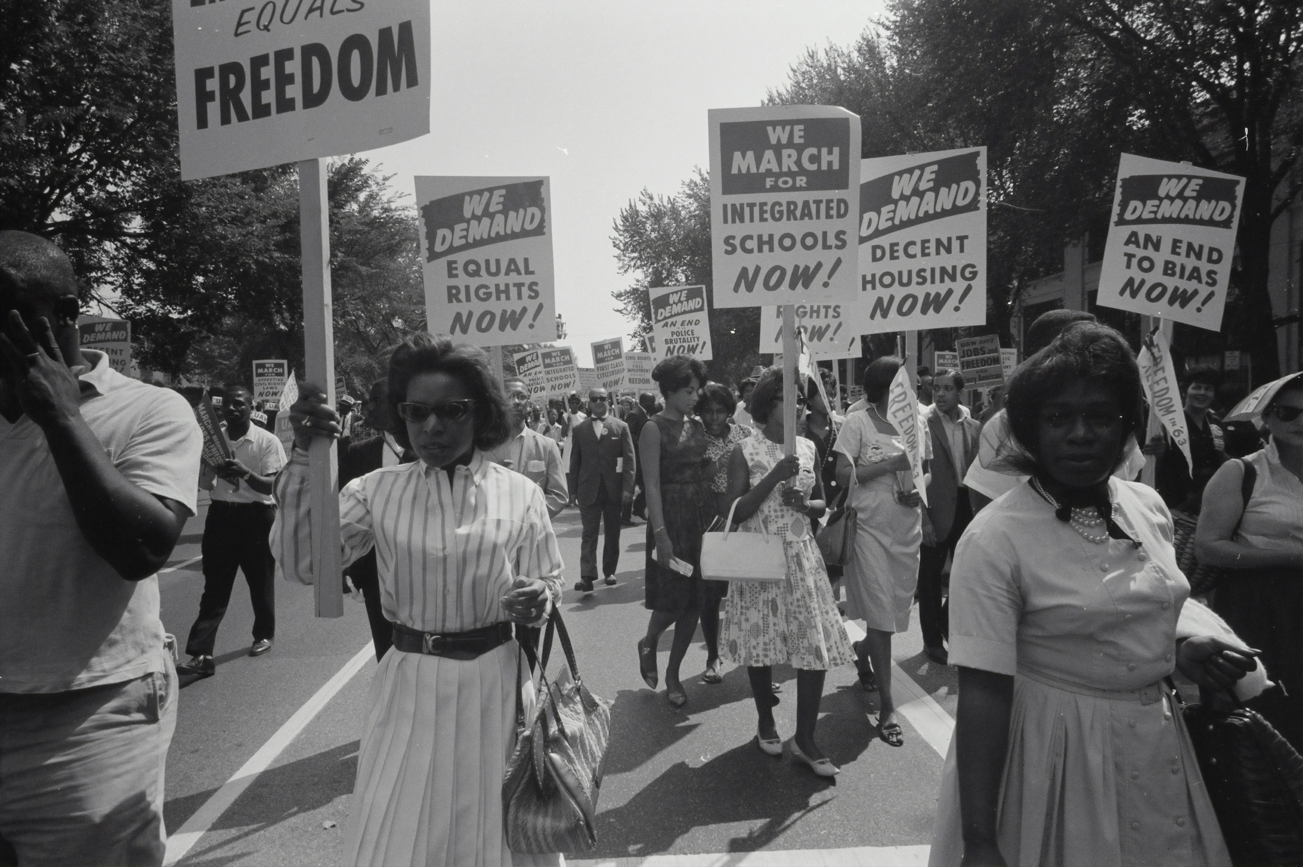
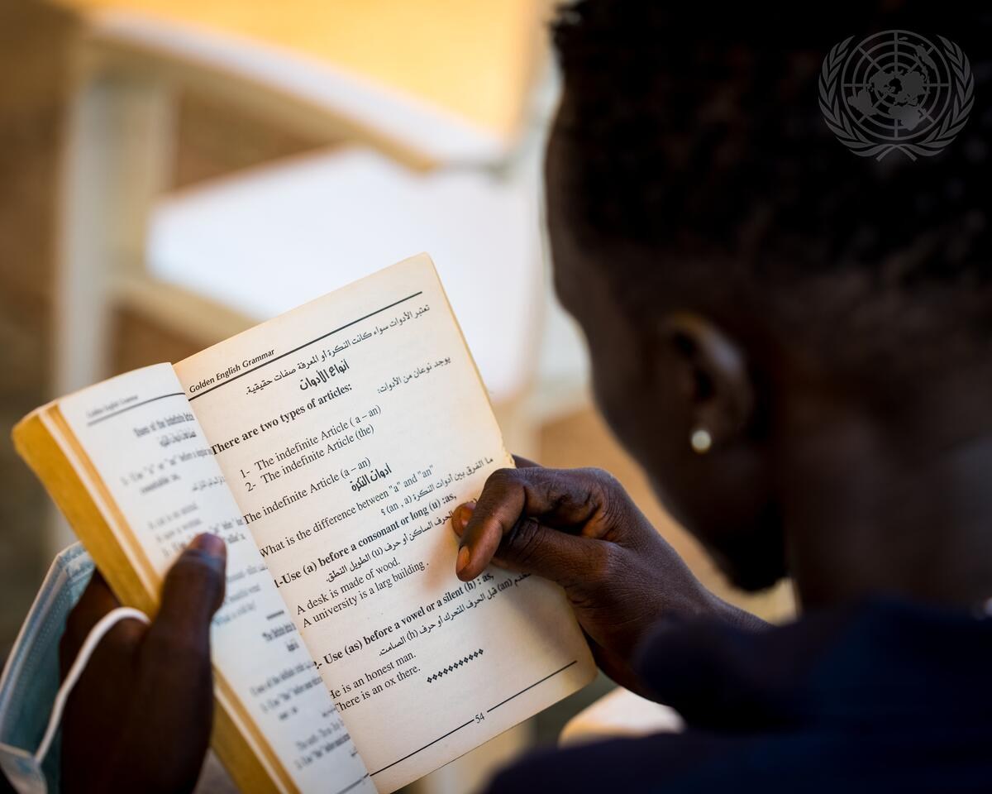
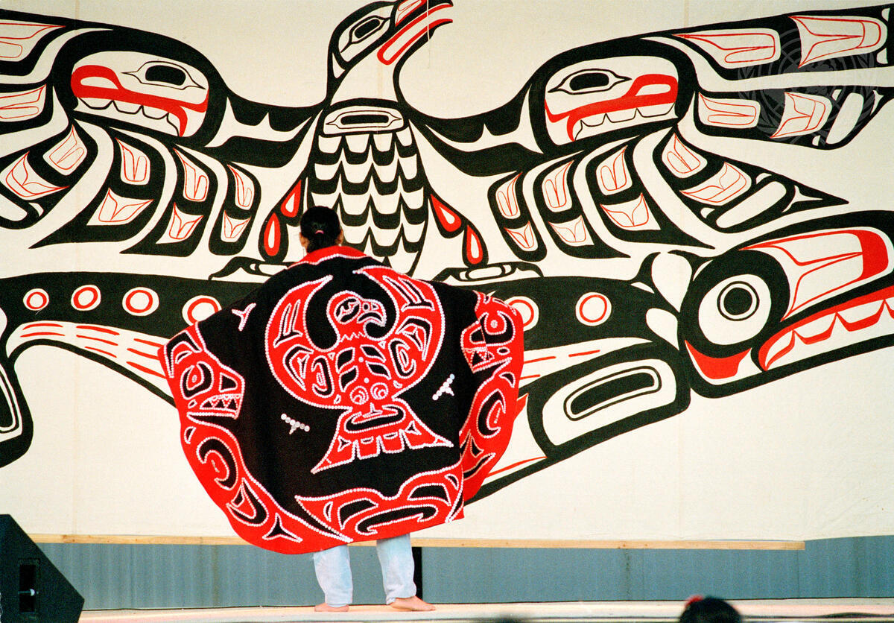
Generations of Rights
First Generation: Civil and Political Rights
E.g. Right to life, freedom from torture, freedom of expression, right to fair trial, political participation rights
Second Generation: Economic, Social and Cultural Rights
E.g. Right to education, Right to health, Right to adequate standard of living, Right to work, Cultural rights
Third Generation: Collective Rights
E.g. Self-determination (potentially, right to development, right to a healthy environment

Slide 13
Key Principles
Universality
Universality = Rights apply to all humans everywhere
Cultural Relativism vs. Universalism
Cultural relativist
Different societies have different values and conceptions of rights
Western individualism doesn't reflect all worldviews, and Universal rights represent cultural imperialism (in other words, IHRL is ethnocentric)
Rights must be understood in context
Universalists
Basic rights like life and freedom from torture cannot depend on culture
Cultural relativism often masks oppression, particularly of women and minorities
Culture isn't static—it changes and evolves

Slide 14
Key Principles
Indivisibility and Interdependence
All rights are interconnected and equally important.
All human rights have equal status and cannot be positioned in a hierarchical order.
Denial of one right invariably impedes the enjoyment of other rights. E.g. the right of everyone to an adequate standard of living cannot be compromised at the expense of other rights, such as the right to health or the right to education.
Being able to benefit from one right may depend upon the fulfilment of others.

Slide 15
Rights Holders and Duty Bearers
Right bearers
The individual, Groups (collective rights)
Duty bearers
States (primarily)
Vertical obligations: state's duties toward individuals under its jurisdiction
Horizontal obligations: state's duty to protect individuals from violations by other private actors. E.g. Torture, non-discrimination in housing
Human Rights Committee, General Comment No. 31, para 8.
The Covenant cannot be viewed as a substitute for domestic criminal or civil law. However the positive obligations on States Parties to ensure Covenant rights will only be fully discharged if individuals are protected by the State, not just against violations of Covenant rights by its agents, but also against acts committed by private persons or entities …. in so far as they are amenable to application between private persons or entities

Slide 16
Rights Holders and Duty Bearers
Duty bearers
International organisations (e.g. Peacekeeping)
Interpretation of the Agreement of 25 March 1951 between the WTO and Egypt, Advisory Opinion, 1980, ICJ para 37.
“International organizations are subjects of international law and, as such, are bound by any obligations incumbent upon them under general rules of international law, under their constitutions or under international agreements to which they are parties…”

Slide 17
Scope of IHRL
States must respect the rights of people within their territory and those subject to their jurisdiction. See ICCPR Art. 2 (1)
Irrespective of nationality or legal status
Extra-territoriality
Legal Consequences of the Construction of a Wall in the Occupied Palestinian Territory, Advisory Opinion, ICJ, 2004, para 109
…while the jurisdiction of States is primarily territorial, it may sometimes be exercised outside the national territory. Considering the object and purpose of the International Covenant on Civil and Political Rights, it would seem natural that, even when such is the case, States parties to the Covenant should be bound to comply with its provisions…in adopting the wording chosen, the drafters of the Covenant did not intend to allow States to escape from their obligations when they exercise jurisdiction outside their national territory…

Slide 18
Scope of IHRL
Extra-territoriality
Armed Activities on the Territory of the Congo (Democratic Republic of the Congo v. Uganda), Judgment, I.C.J. Reports 2005.
The Court, having concluded that Uganda was an occupying Power in Ituri at the relevant time, finds that Uganda’s responsibility is engaged both for any acts of its military that violated its international obligations and for any lack of vigilance in preventing violations of human rights and international humanitarian law by other actors present in the occupied territory, including rebel groups acting on their own account. (para 179)
…
The Court further concluded that international human rights instruments are applicable “in respect of acts done by a State in the exercise of its jurisdiction outside its own territory”, particularly in occupied territories… (para 216)
Even sometimes when the state has no effective control: See also Human Rights Committee, Sergio Euben Lopez Burgos v. Uruguay, Communication No. R.12/52 (6 June 1979), U.N. Doc. Supp. No. 40 (A/36/40) at 176 (1981), para 12.3.

Slide 19
Derogations in Time of Emergency
Absolute and limited Rights
ICCPR Article 4
1 . In time of public emergency which threatens the life of the nation and the existence of which is officially proclaimed, the States Parties to the present Covenant may take measures derogating from their obligations under the present Covenant to the extent strictly required by the exigencies of the situation, provided that such measures are not inconsistent with their other obligations under international law and do not involve discrimination solely on the ground of race, colour, sex, language, religion or social origin.
2. No derogation from articles 6, 7, 8 (paragraphs I and 2), 11, 15, 16 and 18 may be made under this provision.
ACHR, Article 27
1. In time of war, public danger, or other emergency that threatens the independence or security of a State Party, it may take measures derogating from its obligations under the present Convention to the extent and for the period of
time strictly required by the exigencies of the situation, provided that such measures are not inconsistent with its other obligations under international law and do not involve discrimination on the ground of race, color, sex, language, religion, or social origin.
2. The foregoing provision does not authorize any suspension of the following articles: Article 3 (Right to Juridical Personality), Article 4 (Right to Life), Article 5 (Right to Humane Treatment), Article 6 (Freedom from Slavery), Article 9(Freedom from Ex Post Facto Laws), Article 12 (Freedom of Conscience and Religion), etc.

Slide 20
Derogations in Time of Emergency
Four Substantive requirements
Necessity and proportionality (nature, duration, impact)
Case of Aksoy V. Turkey (Application No. 21987/93) (ECtHR, 20 March 2018), para 78.
“Although the Court is of the view … that the investigation of terrorist offences undoubtedly presents the authorities with special problems, it cannot accept that it is necessary to hold a suspect for fourteen days without judicial intervention. This period is exceptionally long and left the applicant vulnerable not only to arbitrary interference with his right to liberty but also to torture … Moreover, the Government have not adduced any detailed reasons before the Court as to why the fight against terrorism in South-East Turkey rendered judicial intervention impracticable.”
Consistent with state’s other obligations under IL, especially Jus Cogens
Cannot affect absolute or non-derogable rights
Notification requirement

Slide 21

Derogations Outside of Emergency
Conditions
Provided by law and legal (e.g. Constitution)
Serve a legitimate aim described in the limitation clause, e.g. protection of rights and freedom
Necessary in a democratic society. That is responding to a public need, is proportionate and the aim pursued is legitimate.

Slide 22

International Human Rights Machinery

Slide 23
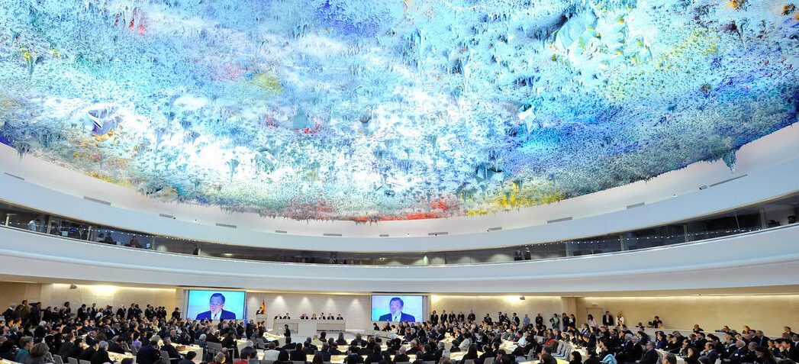
International Human Rights Machinery
Charter-Based Mechanisms
Human Rights Council
Replaced UN Cssn on HR in 2006 (UNGA resolution 60/251)
47 (country) members, elected by UNGA for 3-year terms (max= 2 consecutive terms
Regional distribution of members
The working methods of the Council can be divided into 4 categories: Regular and special sessions, Universal Periodic Review and the special procedures

Slide 24
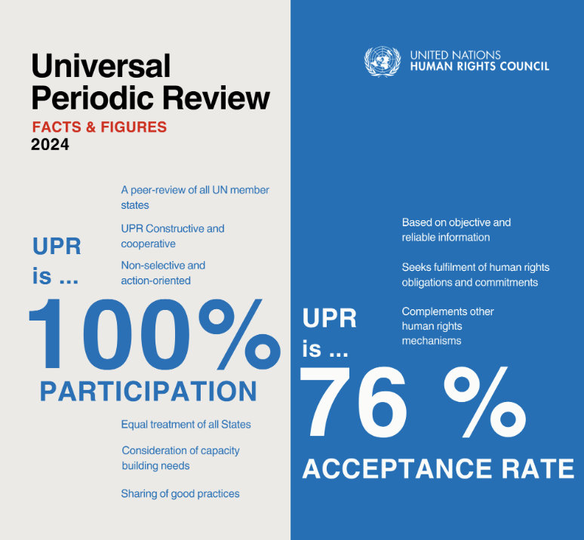
International Human Rights Machinery
Charter-Based Mechanisms
Human Rights Council - Universal Periodic Review (UPR)
Each member state is reviewed every 4.5 years
States (and NGOs) submit reports
Working group (47 members) reviews the reports
Working group issues an “Outcome Report” including recommendations to member states under review
States accept or note the recommendations.

Slide 25
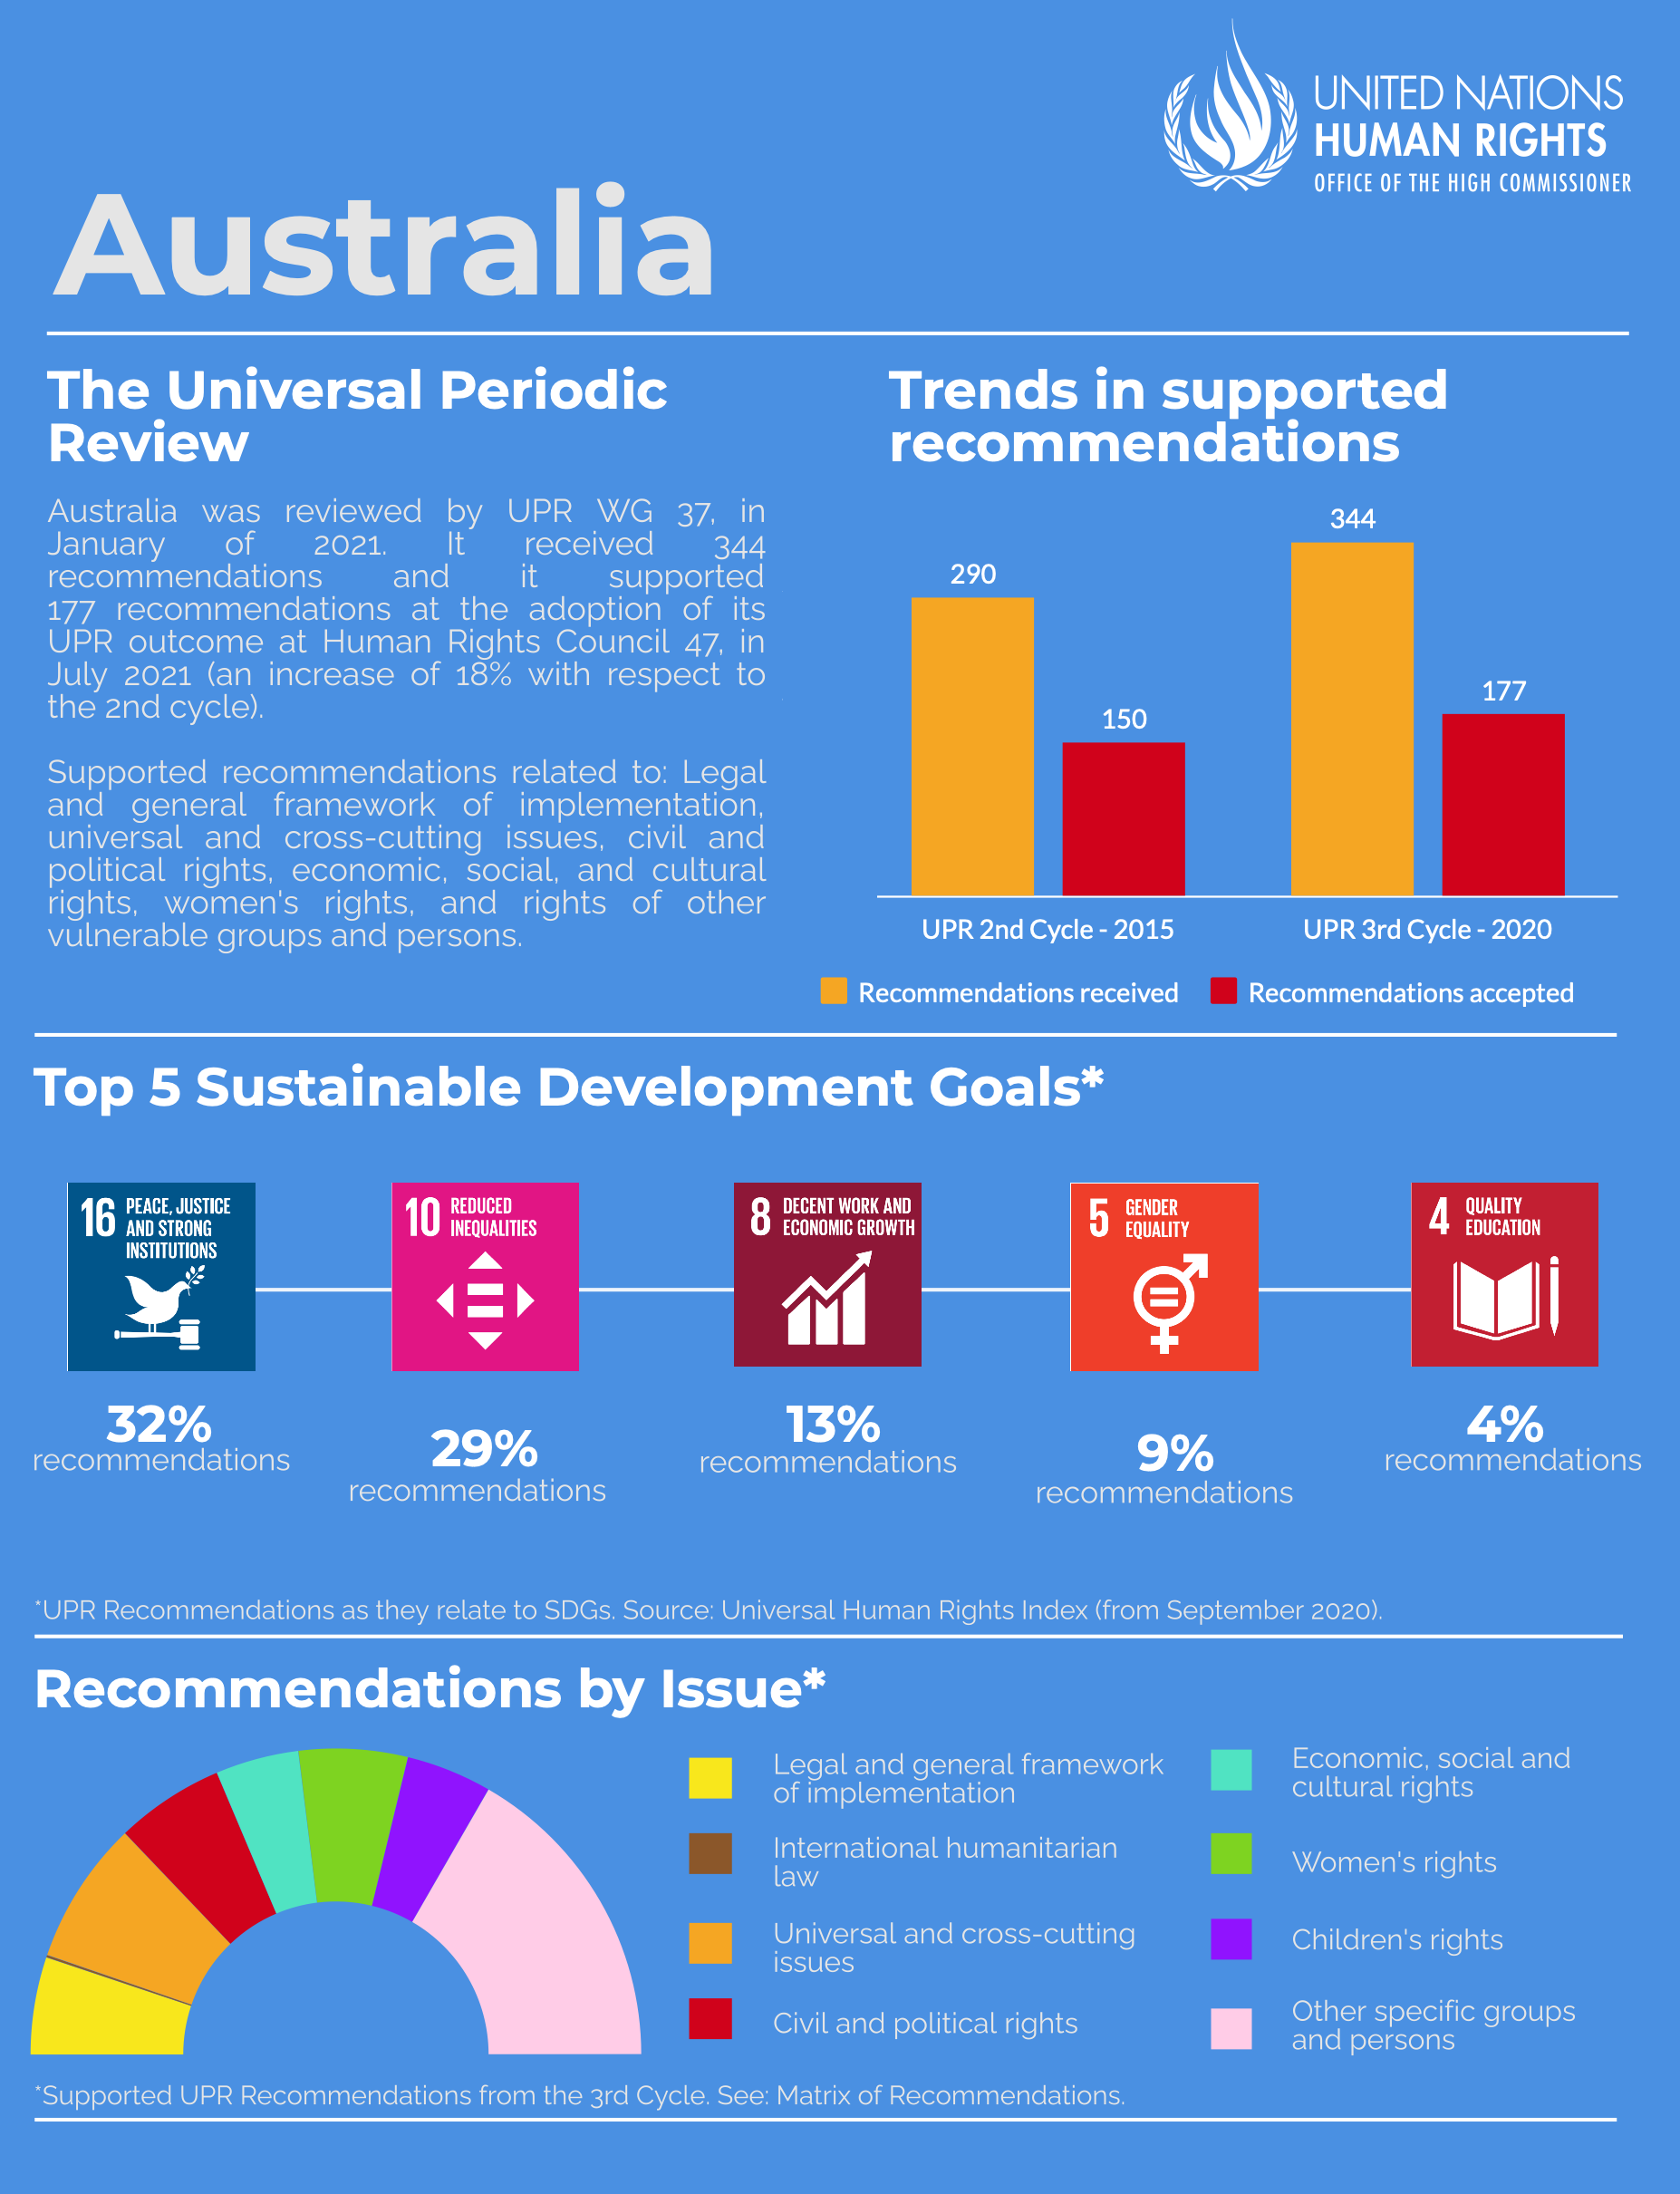
International Human Rights Machinery
Charter-Based Mechanisms
Australia and the UPR

Slide 26
International Human Rights Machinery
Charter-Based Mechanisms
Special Procedures
System of independent experts—special rapporteurs, independent experts, and working groups
46 thematic mandates (e.g. right to privacy, right to food, human rights and climate change.
14 country mandates: investigate violations in specific countries (e.g. CAR, Belarus, Russia, Cambodia)
Methods of Work
Conduct country visits (with state consent)
Receive individual complaints
Issue reports on international human rights within their mandate to foster a better understanding of these norms and their implementation.

Slide 27
International Human Rights Machinery
Treaty-Based Mechanisms
Treaty Bodies S
Cvn v Racial Dicrimination (1965) - Committee on the Elimination of Racial Discrimination (ICERD)
ICESCR (1966) – Committee on Economic, Social and Cultural Rights (CESCR)
ICCPR (1966) – Human Rights Committee
Cvn v Discrimination v Women (1979) –Committee on the Elimination of Discrimination against Women (CEDAW)
Cvn against Torture (1984) – Committee against Torture (CAT)
Cvn on Rights of the Child (1989) – Committee on the Rights of the Child (CROC)
Cvn on Rights of Migrant Workers (1992) - Committee on Migrant Workers (CMW)
Cvn Rights of Persons with Disabilities (2006) – Committee on the Rights of Persons with Disabilities (CRPD)
Cvn Enforced Disappearance (2006) – Committee on Enforced Disappearances (CED)
Optional Protocol to the Convention Against Torture (2002) - Subcommittee on Prevention of Torture and other Cruel, Inhuman or Degrading Treatment or Punishment (SPT)

Slide 28



International Human Rights Machinery
Treaty-Based Mechanisms
States must submit initial reports after ratifying a treaty, followed by periodic reports. Includes dialogue with states followed by concluding observations and recommendations.
State Reporting
Committees issue authoritative interpretations of treaty provisions called "general comments" or "general recommendations.” Considered authoritative.
General Comments
Written, confidential proceedings modeled on judicial practice. Full opportunity for both parties to respond to pleadings. Adoption of "views" Published jurisprudence used for authoritative treaty interpretation.
Individual Complaints Procedures
Inter-State Complaints
Extremely rare. Only three interstate complaints have ever been brought, all of which under ICERD. Only the ICERD does not require reciprocal declarations

Slide 29
International Human Rights Machinery
Treaty-Based Mechanisms – Legal nature of Outputs
Treaty body decisions are not binding but carry significant weight.
Ahmadou Sadio Diallo (Republic of Guinea v. Democratic Republic of the Congo), Merits, Judgment, ICJ, 2010, para 66.
“Although the Court is in no way obliged, in the exercise of its judicial functions, to model its own interpretation of the Covenant on that of the Committee, it believes that it should ascribe great weight to the interpretation adopted by this independent body that was established specifically to supervise the application of that treaty. The point here is to achieve the necessary clarity and the essential consistency of international law, as well as legal security…”
See also, Application of the International Convention on the Elimination of All Forms of Racial Discrimination (Qatar V. United Arab Emirates) (Preliminary Objections), ICJ, 2021, para 101.

